Slide 1
Human Trafficking In Western Europe
Student Name
Institution Affiliation

Slide 2
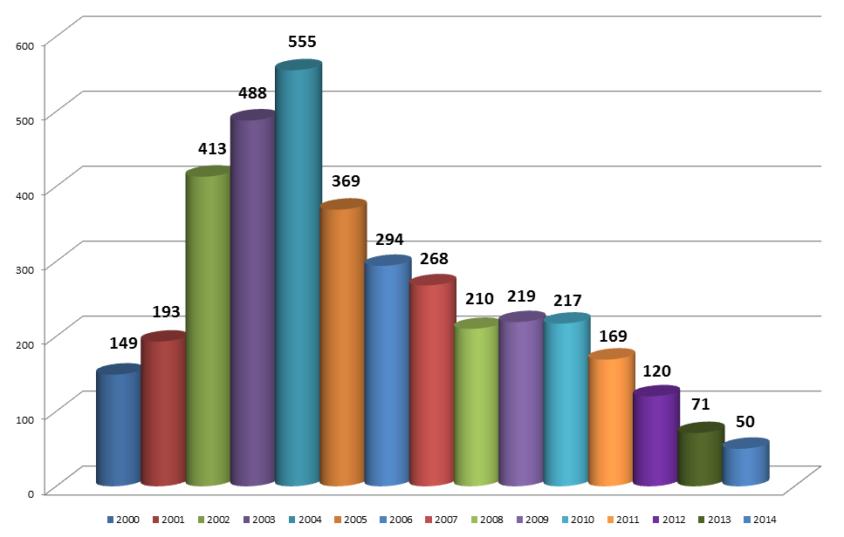
Overview of the Presentation
Understanding the concept of Human Trafficking
Identifying the route cause of human trafficking in Western Europe
Identifying the prevalence of Human Trafficking in western Europe
The Recruitment basis of Victims of human trafficking in Western Europe
Why human trafficking has narrowed down to Child trafficking
Identification of the challenges that most ant-traffickers face
Defining the role of NFGOs in combating human trafficking in western Europe

Slide 3
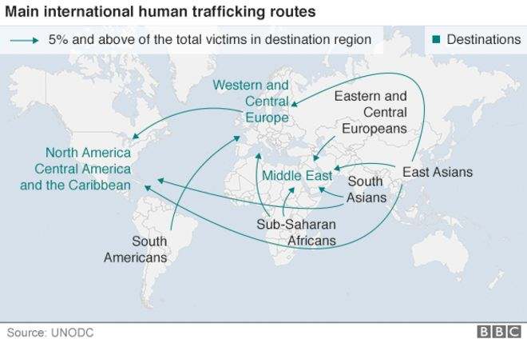
Definition of Human trafficking and How it arises in Western Europe
Human trafficking is a form of modem slavery.
Commercial Sex and labor purposes are the major why humans are trafficked
Coercion, Force, and Fraud methods are used by traffickers to achieve exploration.
Since the fall of Communism, human trafficking has been a concern in Western Europe countries.
Economic promises and hardships has left many individuals in western Europe vulnerable to trafficking.

Slide 4
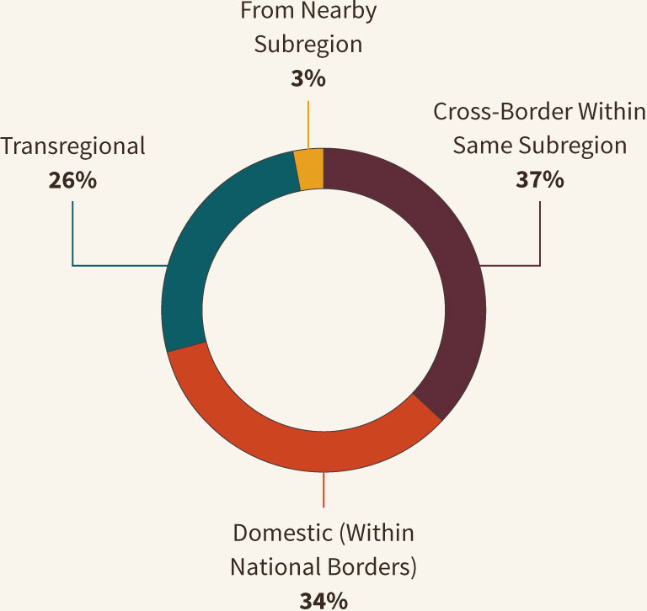
Causes of Human Trafficking in Western Europe
Collapsing of the Soviet Union is the main contributing factor to increased human trafficking
Close proximity and porous borders have made it easy for transportation of victim from the region to withier countries
War and Militarization in Balkans has also contributed to human trafficking in some western Europe countries.

Slide 5
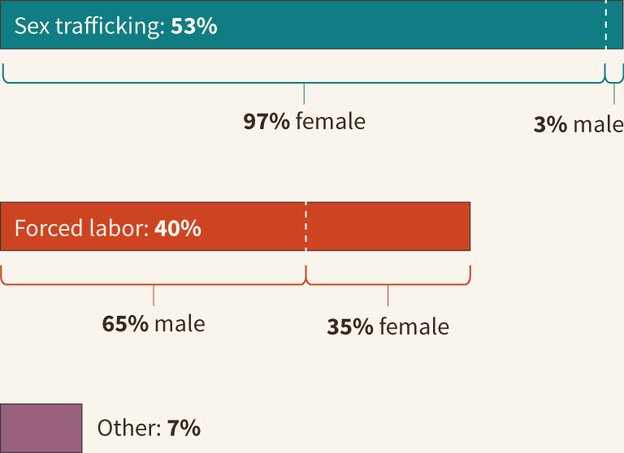
The Prevalence of Human Trafficking in Western Europe
Sex trafficking has received most attention in western Europe
Existence of transitional society majorly accelerated the trade of human beings.

Slide 6
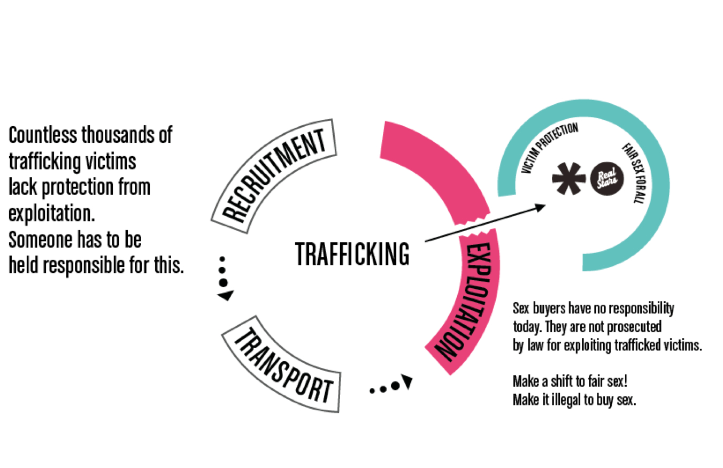
The Recruitment Basis of Victims of Human Trafficking in Western Europe
Ability to utilize advanced technology and personal connections.
Trafficked victims advanced education
Seek of better opportunities of employment abroad by most of the affected victims
Work and study opportunities, films production studios, fake modelling agencies, and employment and marriage agencies are some of the ways that have been used to capturer more educated victims.

Slide 7
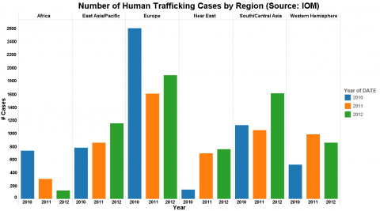
Child Trafficking
The following groups of children are at risk for trafficking in western Europe
Previously trafficked children
Children from ethnic minorities
School drop outs
Those lacking family protection and support
Those who suffer from domestic violence.

Slide 8
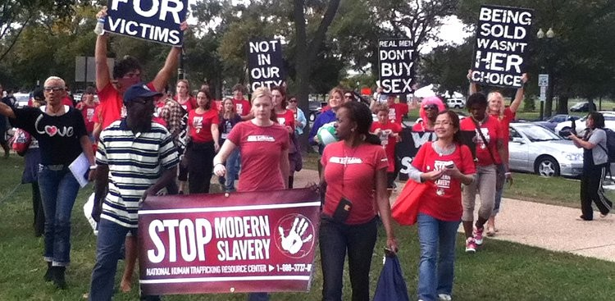
Challenges faced by Anti-Traffickers
Human trafficking data collection and management has always been the challenge due to the following reasons
Disparities in the number of crimes committed and those noticed.
Lack cooperation between the variety of actors
Government and NGOs mistrust.
Victim underreports occurrences due to cultural , linguistic etc. barriers
Misquotation of trafficking incidences during investigation
Lesser charges continue being classified as trafficking incidences due to miss-classification during investigation

Slide 9
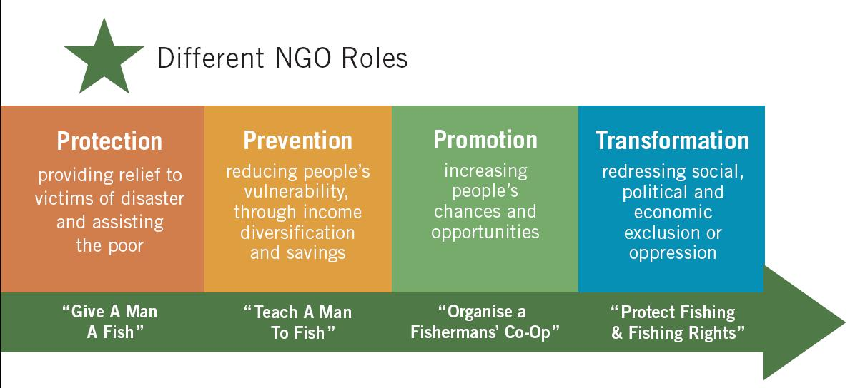
The Role of NGOs in Combating Human Trafficking
Lobbying for victims rights
Research and statistical and informal support
Awareness and educating about risk of trafficking
Reintegration, psychological counselling, social and legal support.

Slide 10
References
Baarda, C. S. (2016). Human trafficking for sexual exploitation from Nigeria into Western Europe: The role of voodoo rituals in the functioning of a criminal network. European Journal of Criminology, 13(2), 257-273.
Breuil, B. C. O., Siegel, D., Van Reenen, P., Beijer, A., & Roos, L. (2011). Human trafficking revisited: legal, enforcement and ethnographic narratives on sex trafficking to Western Europe. Trends in Organized Crime, 14(1), 30-46.
Mordeson, J. N., Mathew, S., & Malik, D. S. (2018). Human trafficking: Source, transit, destination designations. In Fuzzy Graph Theory with Applications to Human Trafficking (pp. 181-208). Springer, Cham.
Petrunov, G. (2011). Managing money acquired from human trafficking: case study of sex trafficking from Bulgaria to Western Europe. Trends in Organized Crime, 14(2-3), 165-183.

